Slide 1

Automated Algorithm Development for Seismic First Break Picking
Robust and Automated Solution on HDF5 Datasets

Slide 2

Introduction and Problem Definition
What are Seismic First Breaks?
Project Objective
Seismic first breaks are the initial arrivals of seismic waves at the receivers. These arrivals are fundamental data used to create the velocity model of the subsurface.
To create a robust, automated method that can accurately detect these first breaks regardless of varying signal-to-noise ratios and variations in first break line behavior across different seismic assets.
Their accurate detection is critical for the success of seismic refraction and tomography studies.
Automating the manual labeling process to save time and reduce costs.

Slide 3

Dataset Overview
Field Name
Description
data_array
2D array of all recorded seismic traces (trace count x sample count)
SHOTID
Shot identifiers
REC_X / REC_Y
Receiver X and Y coordinates
SAMP_RATE
Sampling rate (in microseconds)
SPARE1
First break time values (in ms)
The dataset includes seismic traces from four different real-world seismic assets (Brunswick, Halfmile, Lalor, Sudbury) stored in HDF5 format. In this study, the Halfmile dataset, containing over 1 million traces, was used.

Slide 4
Methodology: Data Organization
Shot Gather Grouping
Line Detection with DBSCAN
Seismic data were first grouped according to SHOTID values. Each shot consists of a series of traces providing a different perspective of the subsurface.
Using receiver coordinates (REC_X, REC_Y), the physical seismic lines to which the traces belong were automatically identified.
However, traces in raw data are not always ordered by physical lines. This requires reorganizing the data for 2D imaging and spatial analysis.
The DBSCAN (Density-Based Spatial Clustering of Applications with Noise) algorithm was used to separate linear line structures from noise and organize each line as an independent 2D seismic image.

Slide 5
Methodology: Pre-processing and AIC Picker
1. Pre-processing (Filtering)
2. AIC Picker Algorithm
A 5-80 Hz Bandpass Filter was applied to clean low-frequency noise and high-frequency scattering in the seismic data.
The Akaike Information Criterion (AIC) identifies the point that minimizes the change in statistical properties (variance) of the signal.
This process enhances the clarity of the first break signal, directly impacting the accuracy of the detection algorithm.
AIC(k) = k * log10(var(before)) + (n-k-1) * log10(var(after))
This method provides more robust results than traditional threshold methods, even in cases with low signal-to-noise ratios.

Slide 6

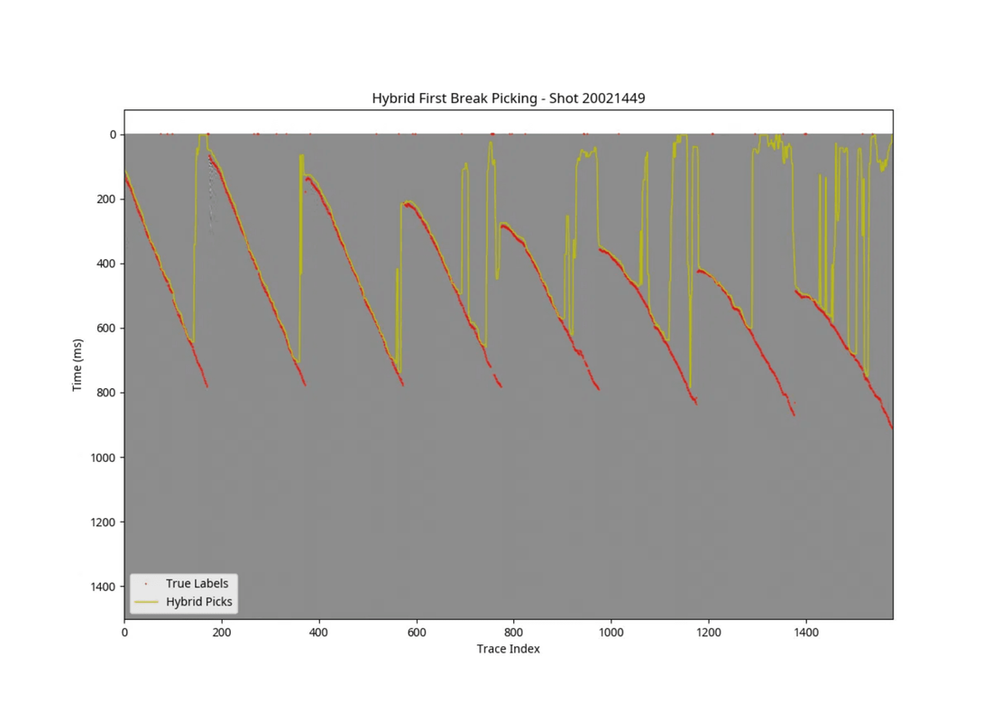
Methodology: Spatial Continuity and Smoothing
Outlier Rejection
Raw picks from the AIC picker can jump on noisy traces. By checking the time difference between adjacent traces, non-physical abrupt changes are identified.
Median Filtering
A median filter is applied to the predicted first break line to ensure spatial continuity. This process cleans up individual errors while preserving the overall trend of the line.
Hybrid Approach
The combination of energy threshold and AIC methods, supported by median filtering, produces stable results across varying signal-to-noise ratios.
Figure 2: First breaks picked by the developed algorithm (yellow line) and true labels (red dots).

Slide 7
Results and Visualization
Algorithm Performance
Visual Validation
The developed hybrid algorithm detects seismic first breaks with high accuracy. The AIC (Akaike Information Criterion) based approach has shown superior success in capturing abrupt changes in signal character.
Examination of seismic sections shows that the algorithm produces robust results even in noisy regions.
In particular, median filtering and spatial continuity checks minimize the impact of erroneous detections (outliers) on individual traces, creating a smooth first break line across the entire section.
Visual analysis confirms that the automatically detected points largely overlap with manual labels, maintaining continuity across seismic lines.

Slide 8

Performance Metrics
Mean Absolute Error (MAE)
Median Absolute Error (MdAE)
85.83 ms
8.00 ms
Average deviation across all traces. Influenced by large errors in some noisy traces.
Median value of the error distribution. Better reflects the typical performance and accuracy of the algorithm.
Metric
Value
Interpretation
Sampling Interval
2.0 ms
Time resolution of the dataset.
MdAE / Sampling
4 Samples
The error margin is approximately 4 sampling intervals.
Success Rate
High
Median error is within acceptable limits for most traces.

Slide 9
Conclusion and Future Work
Study Summary
Future Work
A robust algorithm combining bandpass filtering, AIC picker, and median filtering was developed to automatically detect seismic first breaks.
Extensive testing and parameter optimization on other seismic assets (Brunswick, Lalor, Sudbury).
•
Integration of deep learning-based approaches to improve performance in more complex noise environments (low S/N).
•
The algorithm demonstrated high accuracy with a median error of 8.00 ms compared to manual labels and successfully maintained spatial continuity across seismic lines.
Optimization of the algorithm for real-time data processing workflows and GPU acceleration support.
•

Slide 10
Final Code and Implementation
Core Functions
Processing Pipeline
aic_picker(trace)
1. Data Loading
Performs first break detection based on statistical variance changes.
Reading TRACE_DATA and coordinates from the HDF5 file.
2. Clustering (DBSCAN)
bandpass_filter(data, low, high)
Automatic grouping of traces into receiver lines.
Applies signal cleaning in the 5-80 Hz range.
3. Parallel Processing
pick_line_robust(line_data)
Independent filtering and detection for each line.
Spatially corrects AIC results using median filtering.

